Slide 1

Knowledge Articles
DYNAMICS 365

Slide 2

Mitch Milam
Dynamics CRM Architect
mitch@xrmcoaches.com
@mitchmilam
http://tinyurl.com/MitchMilamLinkedIn

Slide 3
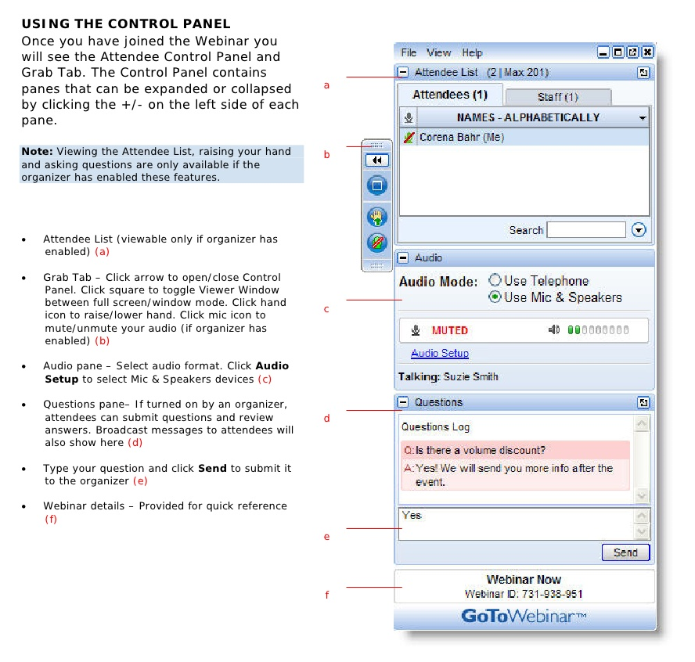
Webinar Housekeeping

Slide 4

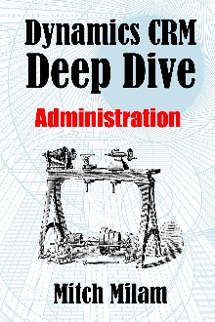
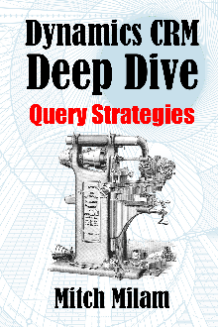
2017 Training Roadmap
Webinars
http://www.xrmcoaches.com/webinars
KnowledgeBits
http://www.xrmcoaches.com/knowledgebits
Learning Plans
http://www.xrmcoaches.com/freestuff
More Goodies
Practice tests
On–Demand video training
Instructor–led training
Books

Slide 5
Agenda
What we are discussing
Configuration
Interactive Service Hub Overview
Process Overview

Slide 6
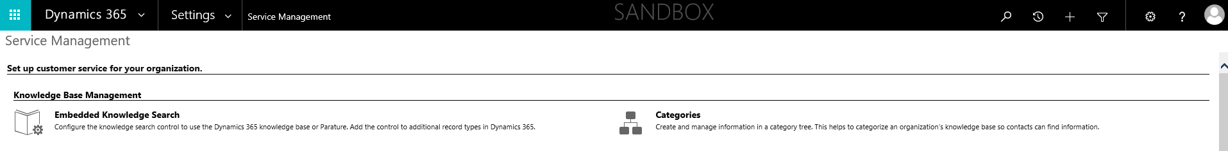
Configuration

Slide 7
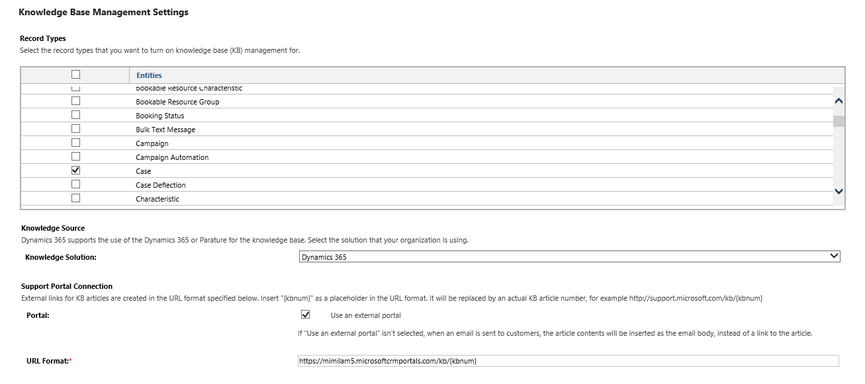
Knowledge Base Management Settings

Slide 8
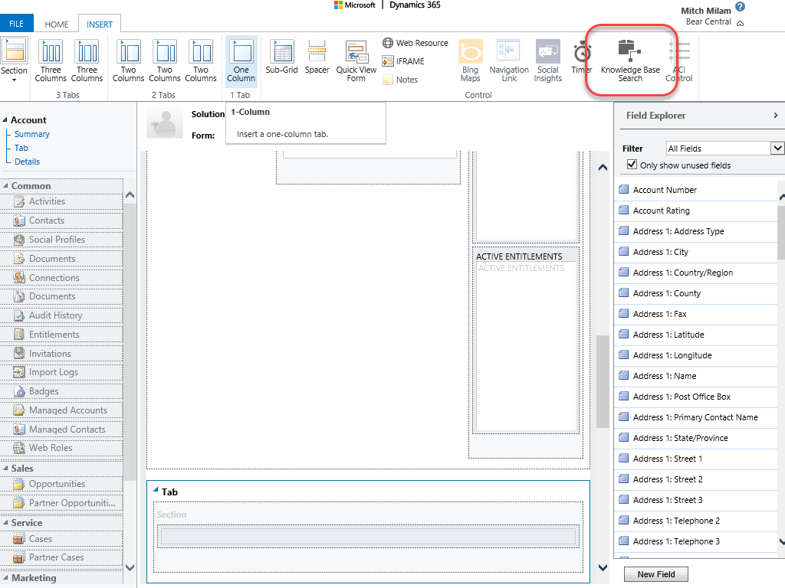
Knowledge Base Search

Slide 9
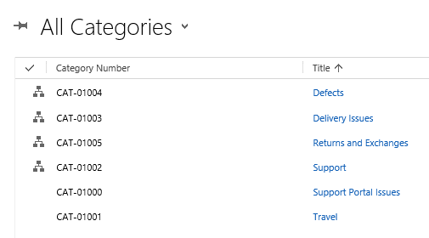
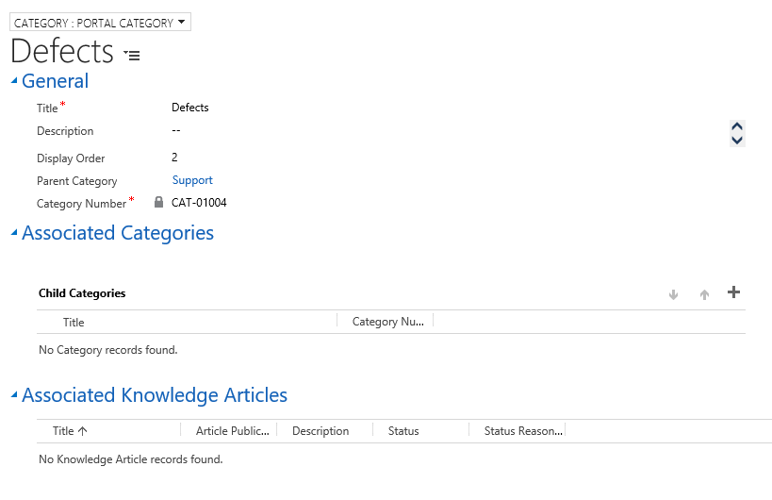
Categories

Slide 10
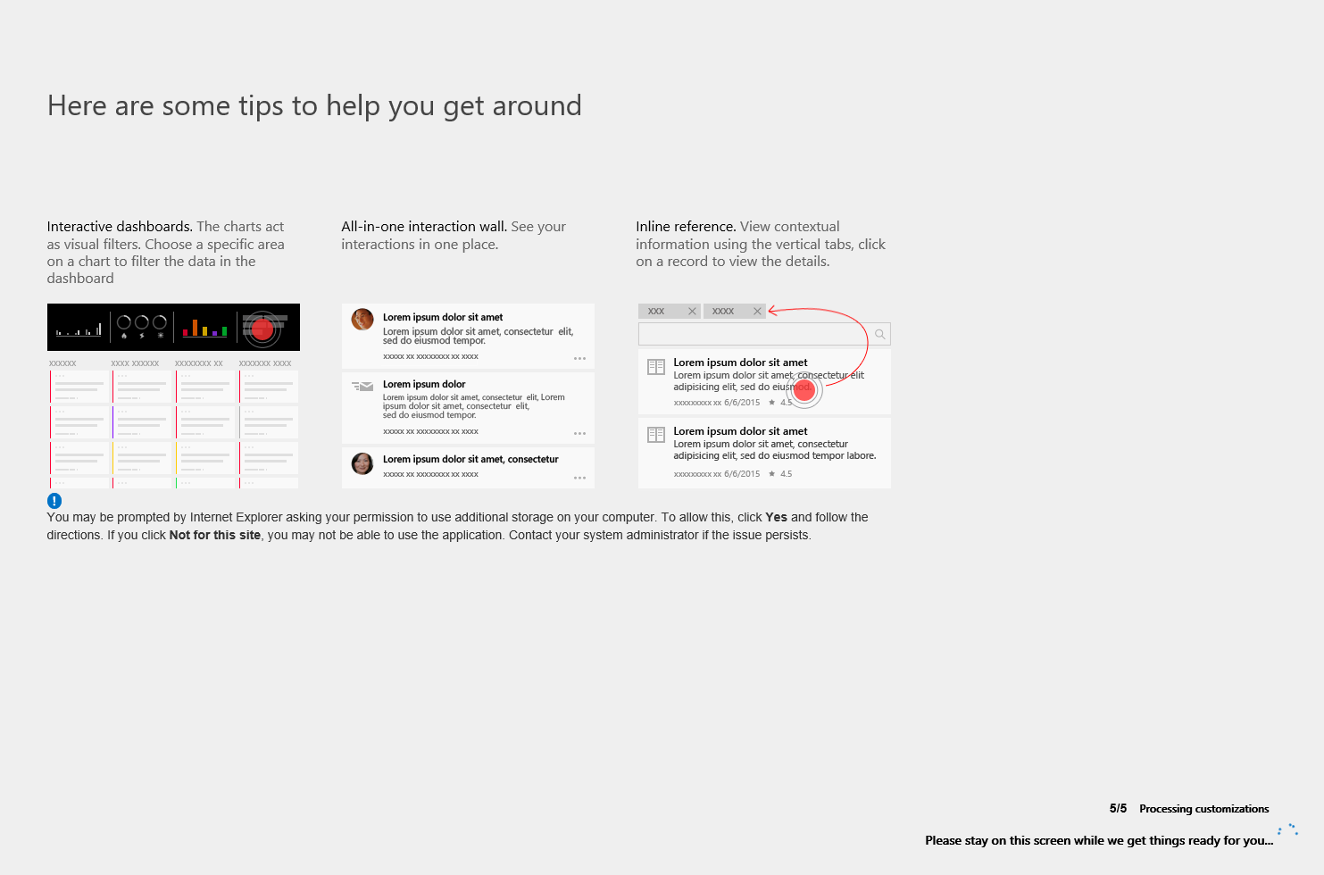
Interactive Service Hub

Slide 11
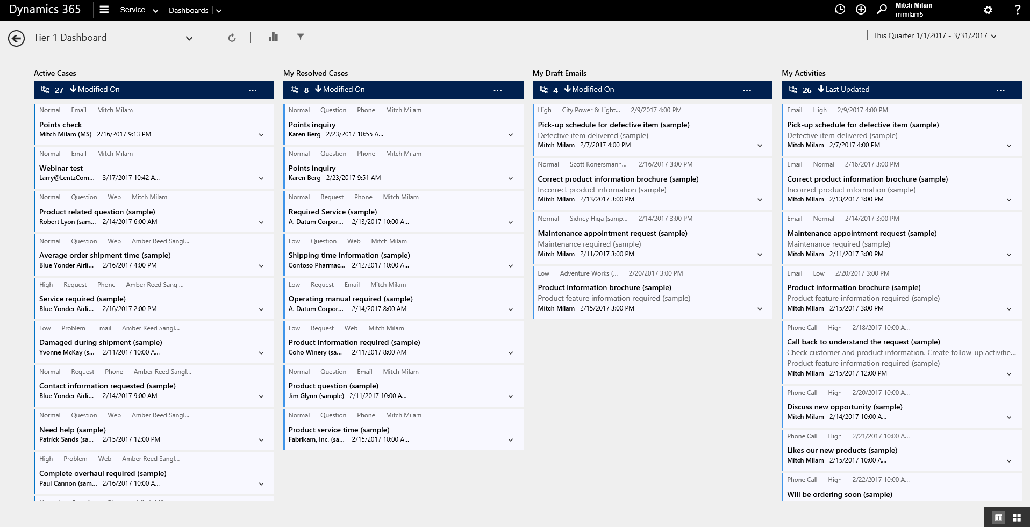
Interactive Service Hub

Slide 12
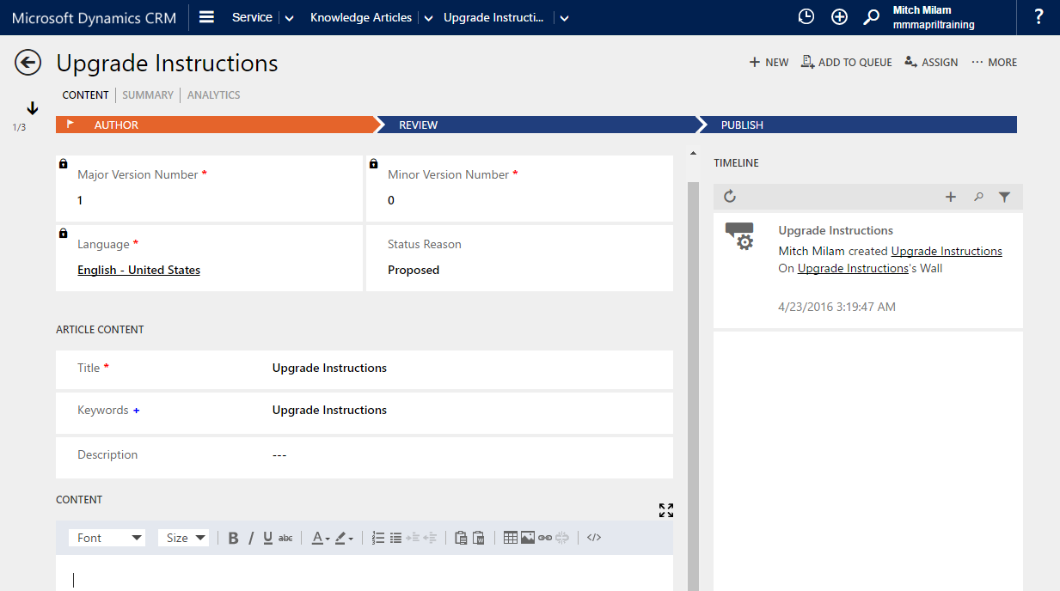
Knowledge Articles

Slide 13
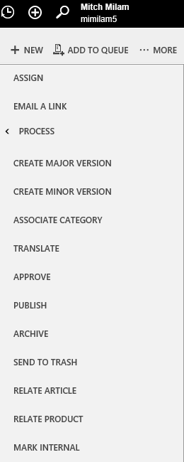
Knowledge Article Actions

Slide 14
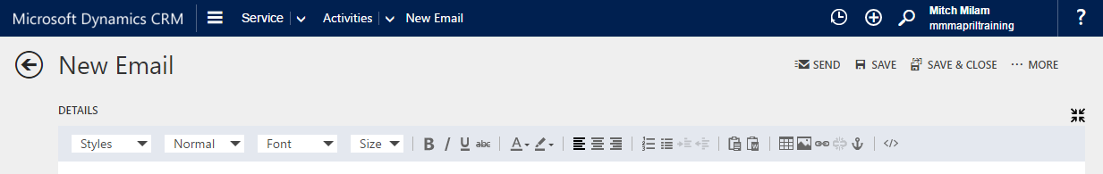
HTML Editor
Email message body
Knowledge Article content

Slide 15
Business Process Flows

Slide 16
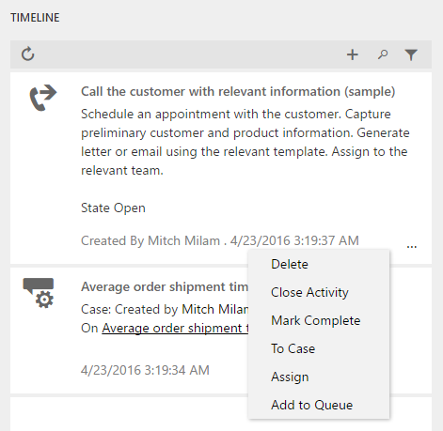
Timeline Quick Actions

Slide 17
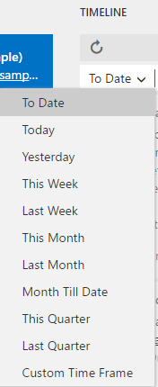
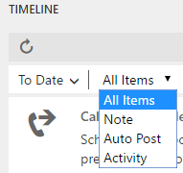
Timeline Filters

Slide 18
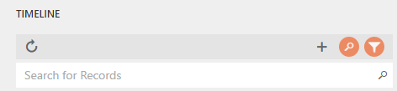
Timeline Search

Slide 19
Publishing Process
Define
Who creates articles
Who reviews articles
Who publishes articles

Slide 20
Revision Process
What denotes a major or minor version?
Is there a difference between a public and internal article?

Slide 21
Portal Access
Content Access Levels
Control what articles are shown to who
There is a default access level

Slide 22
Questions?

Slide 23
Thank You

